Slide 1
Working with Git - Introduction to Git and GitHub
Dr. Ritu Arora
Assistant Professor (Off-Campus)
Department of Computer Science & Information Systems
BITS, Pilani

Slide 2
History of Git
The famous open source project – Linux kernel – used a proprietary DVCS called BitKeeper.
In 2005, the relationship between the company that developed BitKeeper and the Linux community broke down.
The BitKeeper company no longer offered the tool free-of-charge.
The Linux community decide to develop their own DVCS for supporting large open source projects.

Slide 3
What is Git?
Git is a distributed version control system primarily used by developers – for the task of writing code.
It has a command-line interface
It helps to keep track of modifications to your files that are stored in a project repository (“repo”)
Allows a developer to work on his repo either independently or with a team of developers working collaboratively on the same project
It provides a useful environment for team-work; everyone can work independently on the files and merge their changes later
Additionally, it also maintains a permanent record of who made which change.

Slide 4
What is GitHub?
GitHub is a website that allows developers to upload their Git repositories online – on the Internet
GitHub comes with a rich visual interface for navigating the project repositories
It not only helps in providing a backup of the files, but also make collaboration over repositories much more easier and effective
Additionally, it enables other people also to navigate through your repos and hence helps is easier collaboration
It is not mandatory to use Git, while you are using GitHub, however, it is quite common to use GitHub while using Git

Slide 5
What is a Repository?
A repository comprises of all of the project files, along with the revision history of each file.
A project repository helps in managing project work; it also helps in executing collaborative engagements and discussions over the project.
Individual as well as shared ownership (with other people in an organization) of the repository is also possible.
Repository's visibility is used to restrict access to the repository- public / private

Slide 6
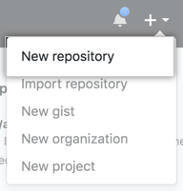
Creating a Repository
One can create a new repository on a personal account or an organization’s account (with sufficient permissions)
For this, navigate to the upper-right corner of the home page of your GitHub account page and use the drop-down menu, and select New repository

Slide 7
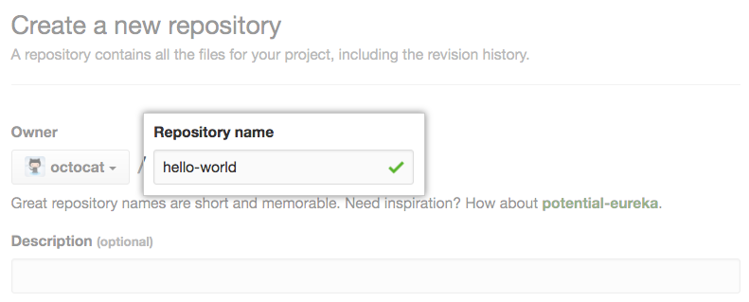
Creating a Repository
Type a name for your repository, and an optional description
Choose a repository visibility – Set it to Public
Choose a license
Click Create repository

Slide 8
Adding ReadMe.md
Add a README file to the repository in order to inform people about the usefulness of your project, what they can do with your project, and how it can be used.
A README is one of the most important document belonging to your repository and is usually the first file that a visitor will read on visiting your repository.
It typically includes the following information:
Details about what the project does,
Usefulness of the project,
Detailed steps on getting started with the project,
Details about where to find help regarding the project,
Details about who maintains and contributes to the project, and much more….

Slide 9
Forking a Repo
In order to contribute to a repo created by someone else, the first step will be to fork that repo into your account.
Typically, most of the repositories are configured so that others (non-owners) are not allowed to directly “push” changes to them.
Instead, one needs to request the administrator of the repository to “pull” the proposed changes from the online repository into the main repository.
In order to do this, it is necessary for you to have a version of the repo on GitHub from where the admin can pull the changes proposed by you.
Hence, forking a repo is generally the first step that is executed in order to make a copy of the current state of the repo and associate that copy with your account.

Slide 10
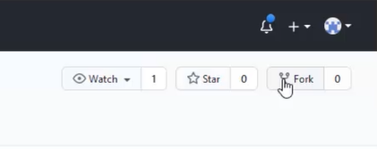
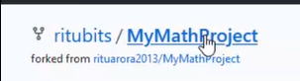
How to fork a repo??
Login into your account on GitHub.
Navigate to the repo you wish to contribute to.
Use the fork option to fork a repo.
Once completed, a writable copy of this repo will be created in your GitHub account.
This process will NOT bring about any changes in your local computer.
Fork option to fork a repo on GitHub
Fork symbol placed in front of a
forked repo

Slide 11
What is a Pull request?
Pull requests are used to inform others about the changes that you have made to your repository on GitHub.
After opening a pull request, one can carry out discussions over the proposed changes with the owner of the open-source project and other collaborators as well.
All can review the proposed and add follow-up commits before merging the changes into the base branch.

Slide 12
Creating a Pull request
Anyone with read permissions to a repository can create a pull request.
In case you wish to create a new branch for your pull request and don't have write permissions to the repository, you need to fork the repository first.
While creating a pull request, one needs to specify the branch into which the changes are to be merged.
Pull requests can only be opened between two branches that are different.

Slide 13
Merging or closing a Pull request
By default, any pull request can be merged at any time (if there does not exist any conflict).
In case of conflict, it is the responsibility of the project owner to manually resolve the conflict and then merge the changes.

Slide 14
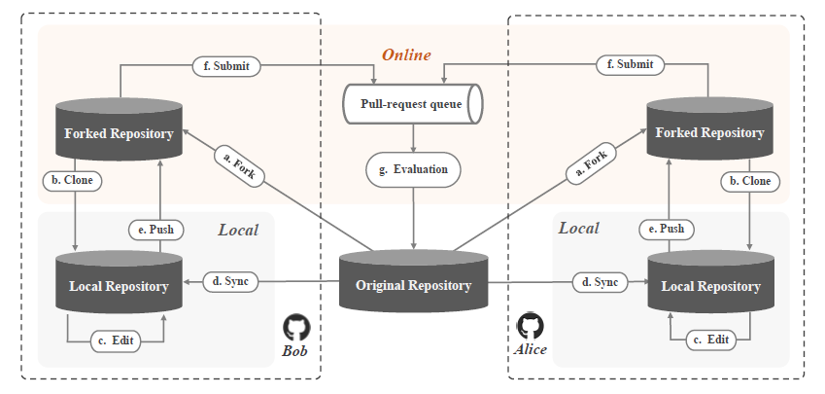
Workflow of Pull based development model
Figure depicting workflow of Pull based development model
Image adapted from: Z. Li et al., "Redundancy, Context, and Preference: An Empirical Study of Duplicate Pull Requests in OSS Projects," in IEEE Transactions on Software Engineering, doi: 10.1109/TSE.2020.3018726.

Slide 15
Cloning a Repo
One can clone a GitHub repository (hosted online) and create a local copy of the same on to the local system.
Cloning a repository brings down a complete copy of the repository data that GitHub has at that point in time, including all versions of every file and folder for the project.
One can now make changes to this local repo, commit them and later push them back to the forked repo on GitHub.

Slide 16
Commit changes to a repo
This helps to save the changes that you would make to your local repository
Commit will not cause any changes to be made to your remote repository on GitHub

Slide 17
Push changes to GitHub
One must push the changes that have been committed in the local repo on to the remote repo on GitHub

Slide 18
Thank You!
In our next session:
Working with Git –
Unique characteristics of Git

